Slide 1



Yuba-Sutter Transit Authority
Next Generation Transit Facility
Final Development Plan
www.yubasuttertransit.com

Slide 2
Transit Facility Site Selection
WORKING PAPER #1

Slide 3
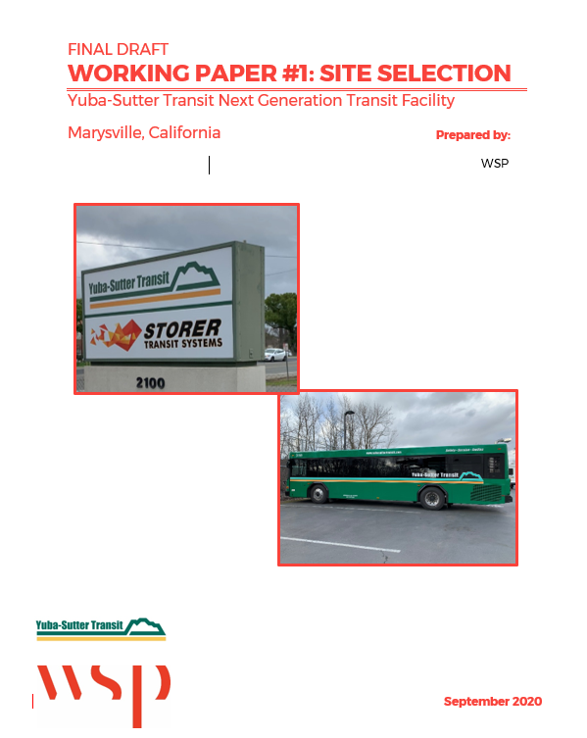
Existing Site Condition
Existing facility
2100 B Street, Marysville (3.18-acre)
  Current vehicles: 57 vehicles (51 Revenue Vehicles)
  Expected future vehicle needs: 85 zero-emission vehicles by 2040 (70 Revenue Vehicles)
  Facility 30,000 sq. feet covered space
Future service will increase operator and administrative staff, and maintenance facility space needs
  Identified need: 9 acres (ideal minimum)
Notes:
Alva

Slide 4
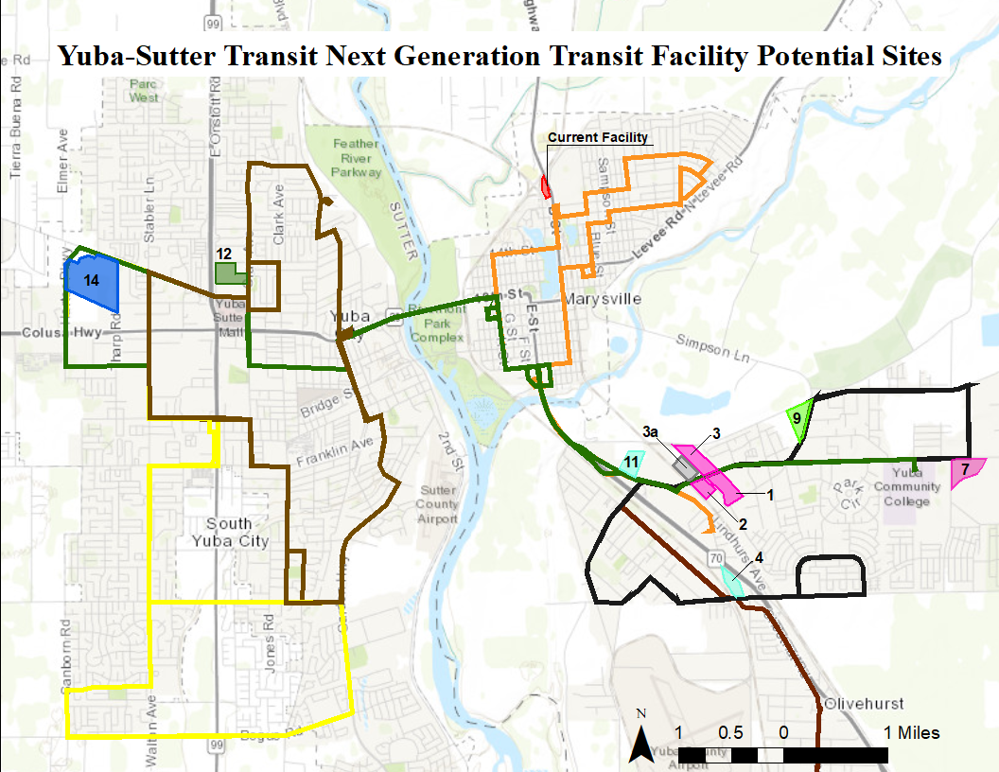
Site Selection & Screening
Preliminary site selection
  16 potential sites from client and realtor
Secondary site selection
  10 potential sites emerged from secondary
  Based on size, shape, proximity to the service area, compatibility with surrounding uses & general feasibility
Technical analysis to narrow to top 3 sites
  Evaluated the sites on criteria related to:
    Planning/operations
    Development costs
    Facilities requirements
    Fueling infrastructure needs
Notes:
"started with x sites, which were id'd based on talks with client and realtor, whittled down to x sites based on general feasibility, and then narrowed down to 3 sites through detailed matrix"

Slide 5
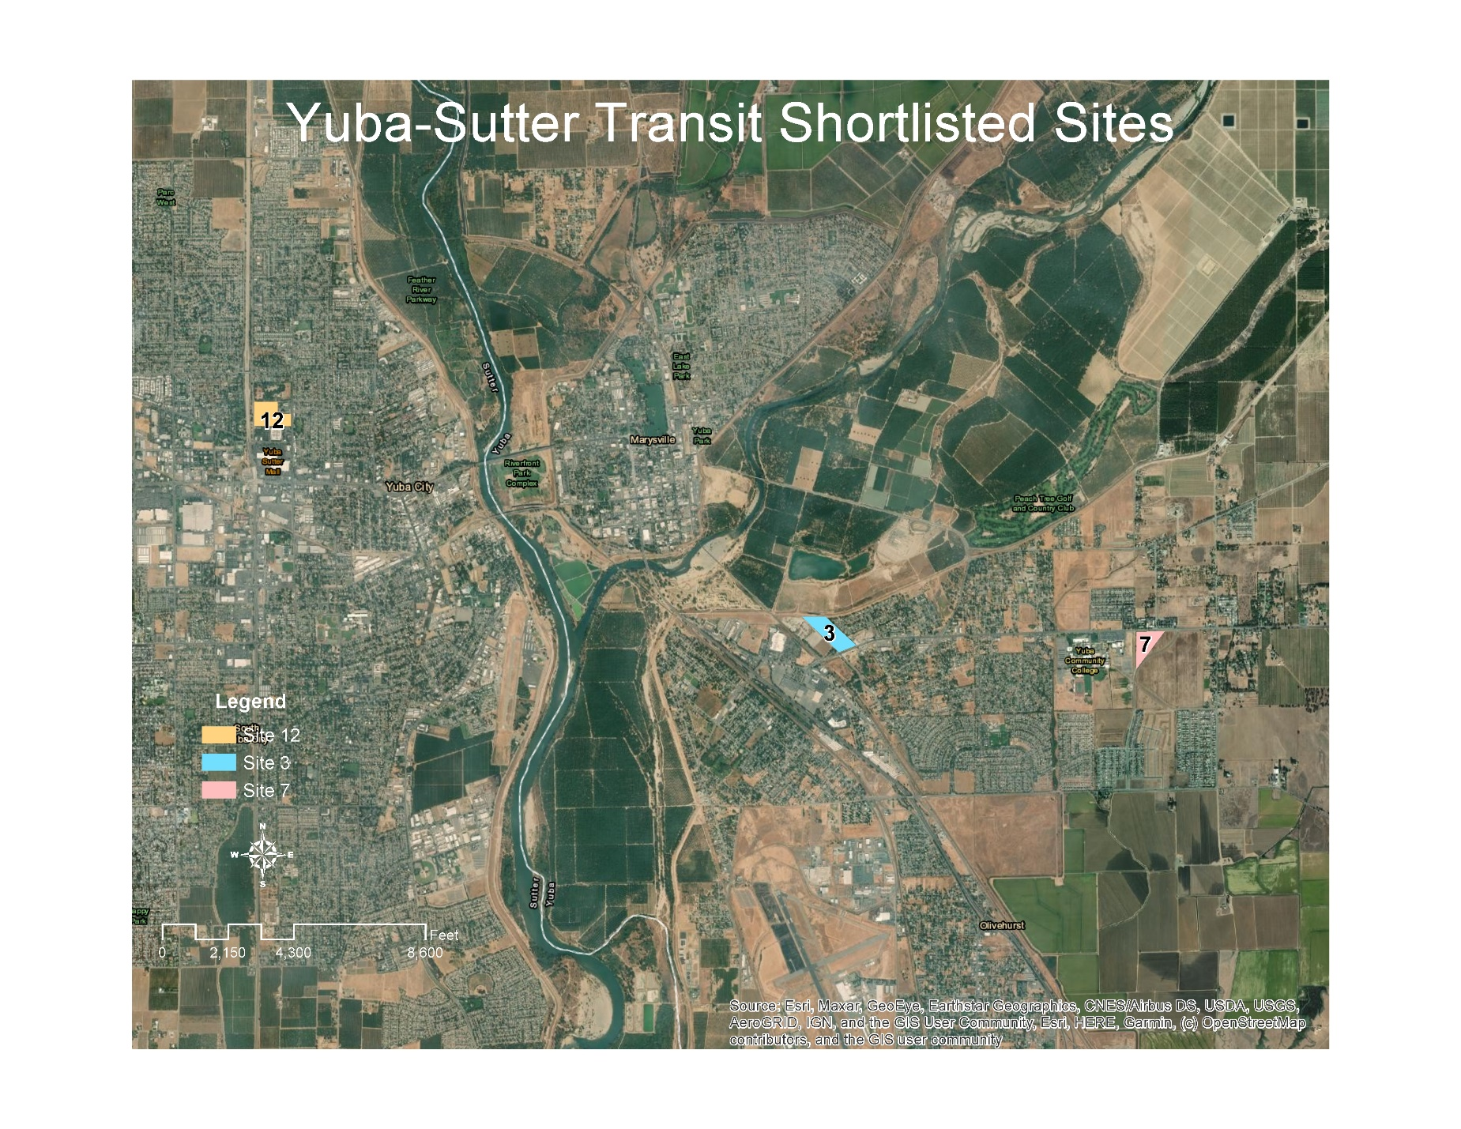
Top 3 Recommended Sites
Notes:
Top 3 recommended sites from analysis

Slide 6
Top 3 Recommended Sites
6035 Avondale Ave (Site 3)
Ample size for ideal facility layout and circulation (19.72 acres), excellent public access, accommodates solar and hydrogen fueling, cheapest per acre option & excellent access for emergency response
Goldfields Parkway & N Beale Road (Site 7)
Ample size (21 acres), excellent access to Yuba College, good public access, multiple points of entry for bus and auto ingress/egress, unknown cost per acre & accommodates solar and hydrogen fueling
1441 E Onstott Road (Site 12)
Sufficient size (10-17.42 acres), good public access (Yuba City), excellent access for emergency response, among the highest cost per acre & low traffic conditions. Does not accommodate hydrogen fueling and accommodates limited solar on bus canopies
Notes:
state if site 12 can accommodate solar/hydrogen or if it would be problematic? No to hydrogen and limited solar on the bus canopies no big field of solar on the ground like can be had at 3 and 7.

Slide 7
Transit Facility Design Criteria
WORKING PAPER #2

Slide 8
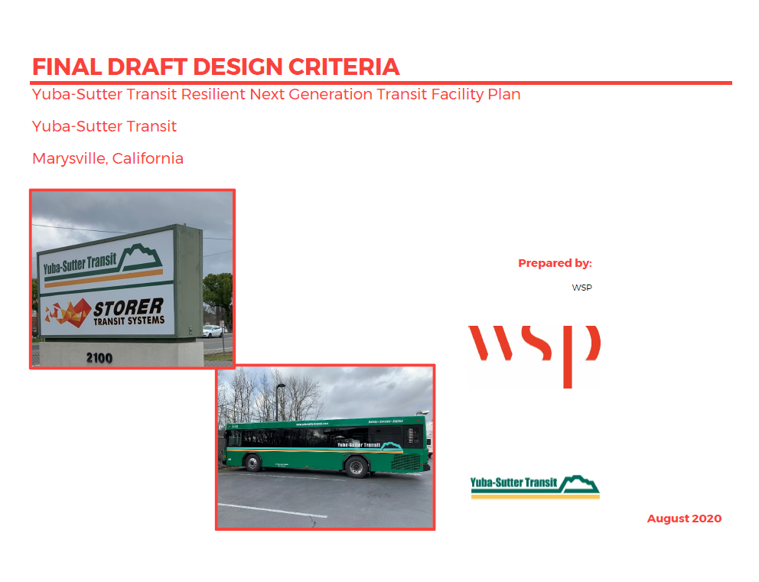
General Considerations
Admin and Operations
Maintenance Facility
Fuel and Wash Facilities (Legacy Fueling)
Agency Vehicle Parking/
Zero Emission Bus (ZEB)
Future-Proofing for Battery
Electric Bus (BEB) &
Hydrogen Fuel Cell Technology
Single loaded drive through vehicle parking
Separate Employee / Visitor Parking

Slide 9
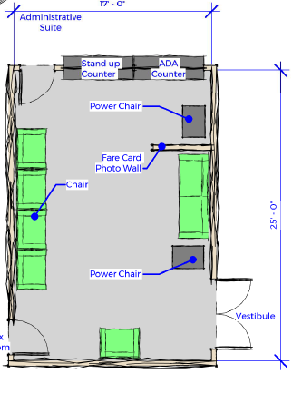
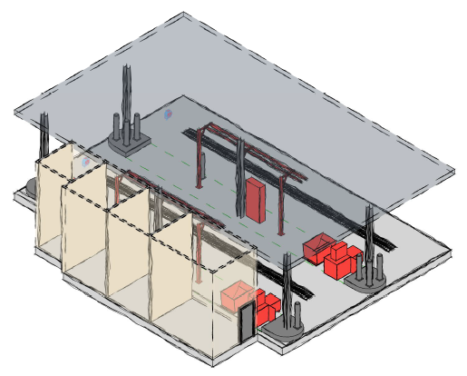
Space Needs & Functional Requirements
Developed based on interviews with Yuba-Sutter Transit staff and contractor regarding the functional requirements and operating characteristics of the bus operating garage.
Total Site Area Required: Ideal minimum 9 acres
Current facility apprx. 30,000 sq. ft. of covered space
Program | Area (sq. ft)*
Administration | 6,890
Operations/Drivers | 8,045
Maintenance | 15,120
Parts Storeroom | 5,245
Fuel/ Wash/ Service | 7,450
Total Facility Space Required | 42,750
Example: Fueling Position
Example: Lobby
*Calculations are approximate.
Notes:
Focus on the key facility components - current transit facility has approximately 30,000 sq. ft. of covered space

Slide 10
Site & Building Requirements
Sustainable facility designed for efficiency based on surrounding climate conditions.
New facility should be designed with planned growth in mind and shall be flexible.
Charging infrastructure for battery electric bus shall be designed into the site and facility.
Site and facility design shall be such to consider hydrogen fuel cell technology to support hydrogen fuel cell electric vehicles.
Design for a healthy workplace environment with adequate natural light into facility.
Notes:
Future ready

Slide 11
Financial Plan

Slide 12
Cost Estimates Summary
Site | Site 3 | Site 7 | Site 12
Land Acquisition (2021) | $900,000 | $2,800,000 | $7,871,000
Soft Costs (Design) | $5,734,486 | $6,346,052 | $5,681,075
Construction (2023 – 2025) | $40,684,495 | $43,893,715 | $40,084,893
Charging/Fueling Infrastructure | $1,368,400 | $2,644,000 | $1,576,320
Total Capital Costs | $48,687,380 | $55,683,767 | $55,213,288
Costs estimates were developed in current year dollars from the ground-up using estimated quantities per site and current market pricing for goods and services
Escalation of 3 percent per year through 2022 was assumed to derive costs in year of construction dollars
  Land costs are based on the current listing price for Sites 3 and 12 (estimated for Site 7). Prices represent current dollar values, with no escalation applied
  Charging costs represent the base utility improvements with charging stations for a fleet of four initial electric vehicles.
Notes:
Cost for construction include over the bus parking canopies.

Slide 13


Development Cost Comparisons
Apples to apples unit costs – same for all three sites.
Site 7 carries a greater Total Initial and Full Build Project Cost by more than $5M over Site 3 and Site 12. This is attributed to higher sitework and battery electric bus AC conduit costs due to more usable site area required.
The off-site improvements for Site 12 are greater than Site 3 and Site 7 due to additional roadway improvements.
Each cost estimate for the three sites has been prepared at a high level primarily for comparison purposes, which are now reflected in the final site scores.

Slide 14
Cash Flow Analysis
Expenditures, or cash outflows, coincide with the construction cost estimates for each site
Funding sources include both existing and future potential funding and financing sources available to Yuba-Sutter Transit
Base Model Assumptions:
  Project timing
    Land Acquisition: 2021
    Construction: 2023 – 2025
  Funding sources meet/exceed construction cost requirements in each year
  Funding shortfalls are covered through grant sources or Transportation Infrastructure Finance and Innovation Act (TIFIA) financing
  Financing Alternatives
    TIFIA Loan Repayment: 2027 – 2046
    Interest Rate: 0.8%
    Debt Service Coverage Ratio: 1.55
Notes:
What is TIFIA?

Slide 15
Funding & Financing
Funding & Financing Sources Considered in the Analysis:
  5339 Competitive Funding
  State Transit Assistance (STA)
  Local Transportation Fund (LTF)
  State of Good Repair Funds
  Low Carbon Transit Operations Program (LCTOP)
  Sacramento Area Council of Governments (SACOG) Competitive Funds
  FTA Formula Funds (5307, 5339, 5311)
  Caltrans Sale Proceeds
  TIFIA Loan Proceeds
If 5339 Competitive or Regional Funds are not received due to their competitive nature, a TIFIA Loan will address the funding gap
STA and LTF funds are used to repay debt service on TIFIA loans
Example Cash Flow for Site 3 with assumed grant funding

Slide 16

NEXT STEPS
Define Facility Needs
Identify Potential Sites
Assess Climate Vulnerability and Resilient Fueling Infrastructure
Design Conceptual Site & Facility
Release Draft Working Paper #1 and #2 for Comments
Collect public comments
Develop Financial Plan
Finalize and Release Final Plan Development
Form Ad Hoc Committee to Develop Preferred Site Recommendation
Board Acceptance of Facility Plan
Procure Property

Slide 17
QUESTIONS & COMMENTS

Slide 18

www.yubasuttertransit.com
Submit comments:
Adam Hansen, Planning Program Manager
Adam@YubaSutterTransit.com
(530) 634-6880
Thank you!

