Slide 1

Yuba-Sutter
Next Generation Transit Facility
RFP No. 04-26
Construction Quality Assurance Services
Pre-Proposal Conference
08/04/2026
3:00pm PT

Slide 2
Agenda
Introductions
Purpose
Project Background
Project Location
Key Facility Features
Scope Overview
RFP Schedule of Events
Proposer Minimum Qualifications
Proposal Evaluation
Proposer Instructions
Questions

Slide 3
Introductions
Yuba-Sutter Transit Authority (Authority)
Matt Mauk, Executive Director
The LeFlore Group
Terrance Brown, Owner’s Representative
Rudy LeFlore, Owner’s Representative
Attendees
Please introduce yourselves, and place the following information in the chat:
Name
Company
Title
Email Address

Slide 4
Purpose
The purpose of today's meeting will be to provide an overview of the project and RFP requirements.
After today’s conference, if you have additional questions, they must be submitted to Adam@yubasuttertransit.com no later than 3:00 pm, PST, August 12, 2026.

Slide 5
Project Background
The Authority intends to construct the Yuba-Sutter Transit Next Generation Transit Facility (NGTF), which will consist of a new administrative, operations, and maintenance facility. The NGTF calls for an approximate 15,000 sq. ft. maintenance building and a 14,000 sq. ft. administration and operations building, along with bus parking, a fuel bay, and a bus wash facility. The facility will be designed for the maintenance of the Authority’s bus fleet and may include energy resiliency features.
The Authority is requesting proposals from California-licensed architects, engineers, or contractors who meet the requirements of California Government Code Section 4529.5 for managing and supervising work on construction projects to provide construction quality assurance services for the NGTF. This project will be executed through a design-build delivery approach in accordance with the California Public Contract Code.

Slide 6
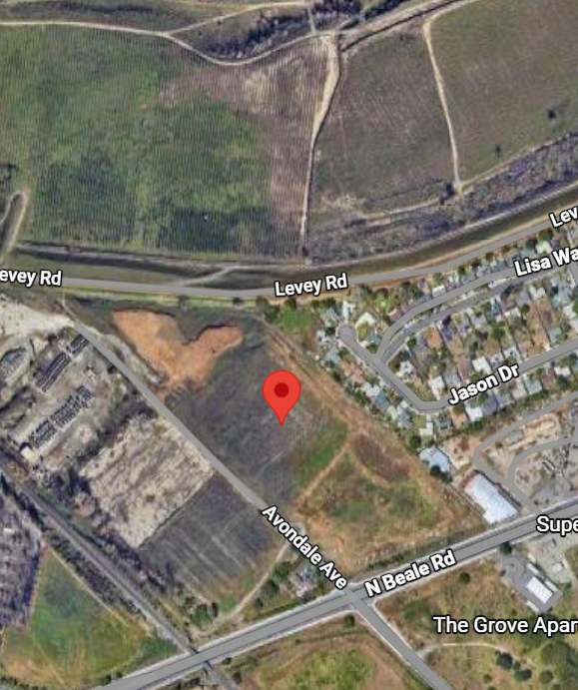
Project Location
The new facility is located at 6035 Avondale Avenue in Linda, CA
  19.72-acre property
  Excellent public and emergency response access
  Ample size for facility layout and circulation, including future expansion of fleet and/or solar farm
Avondale Ave
N Beale Road

Slide 7
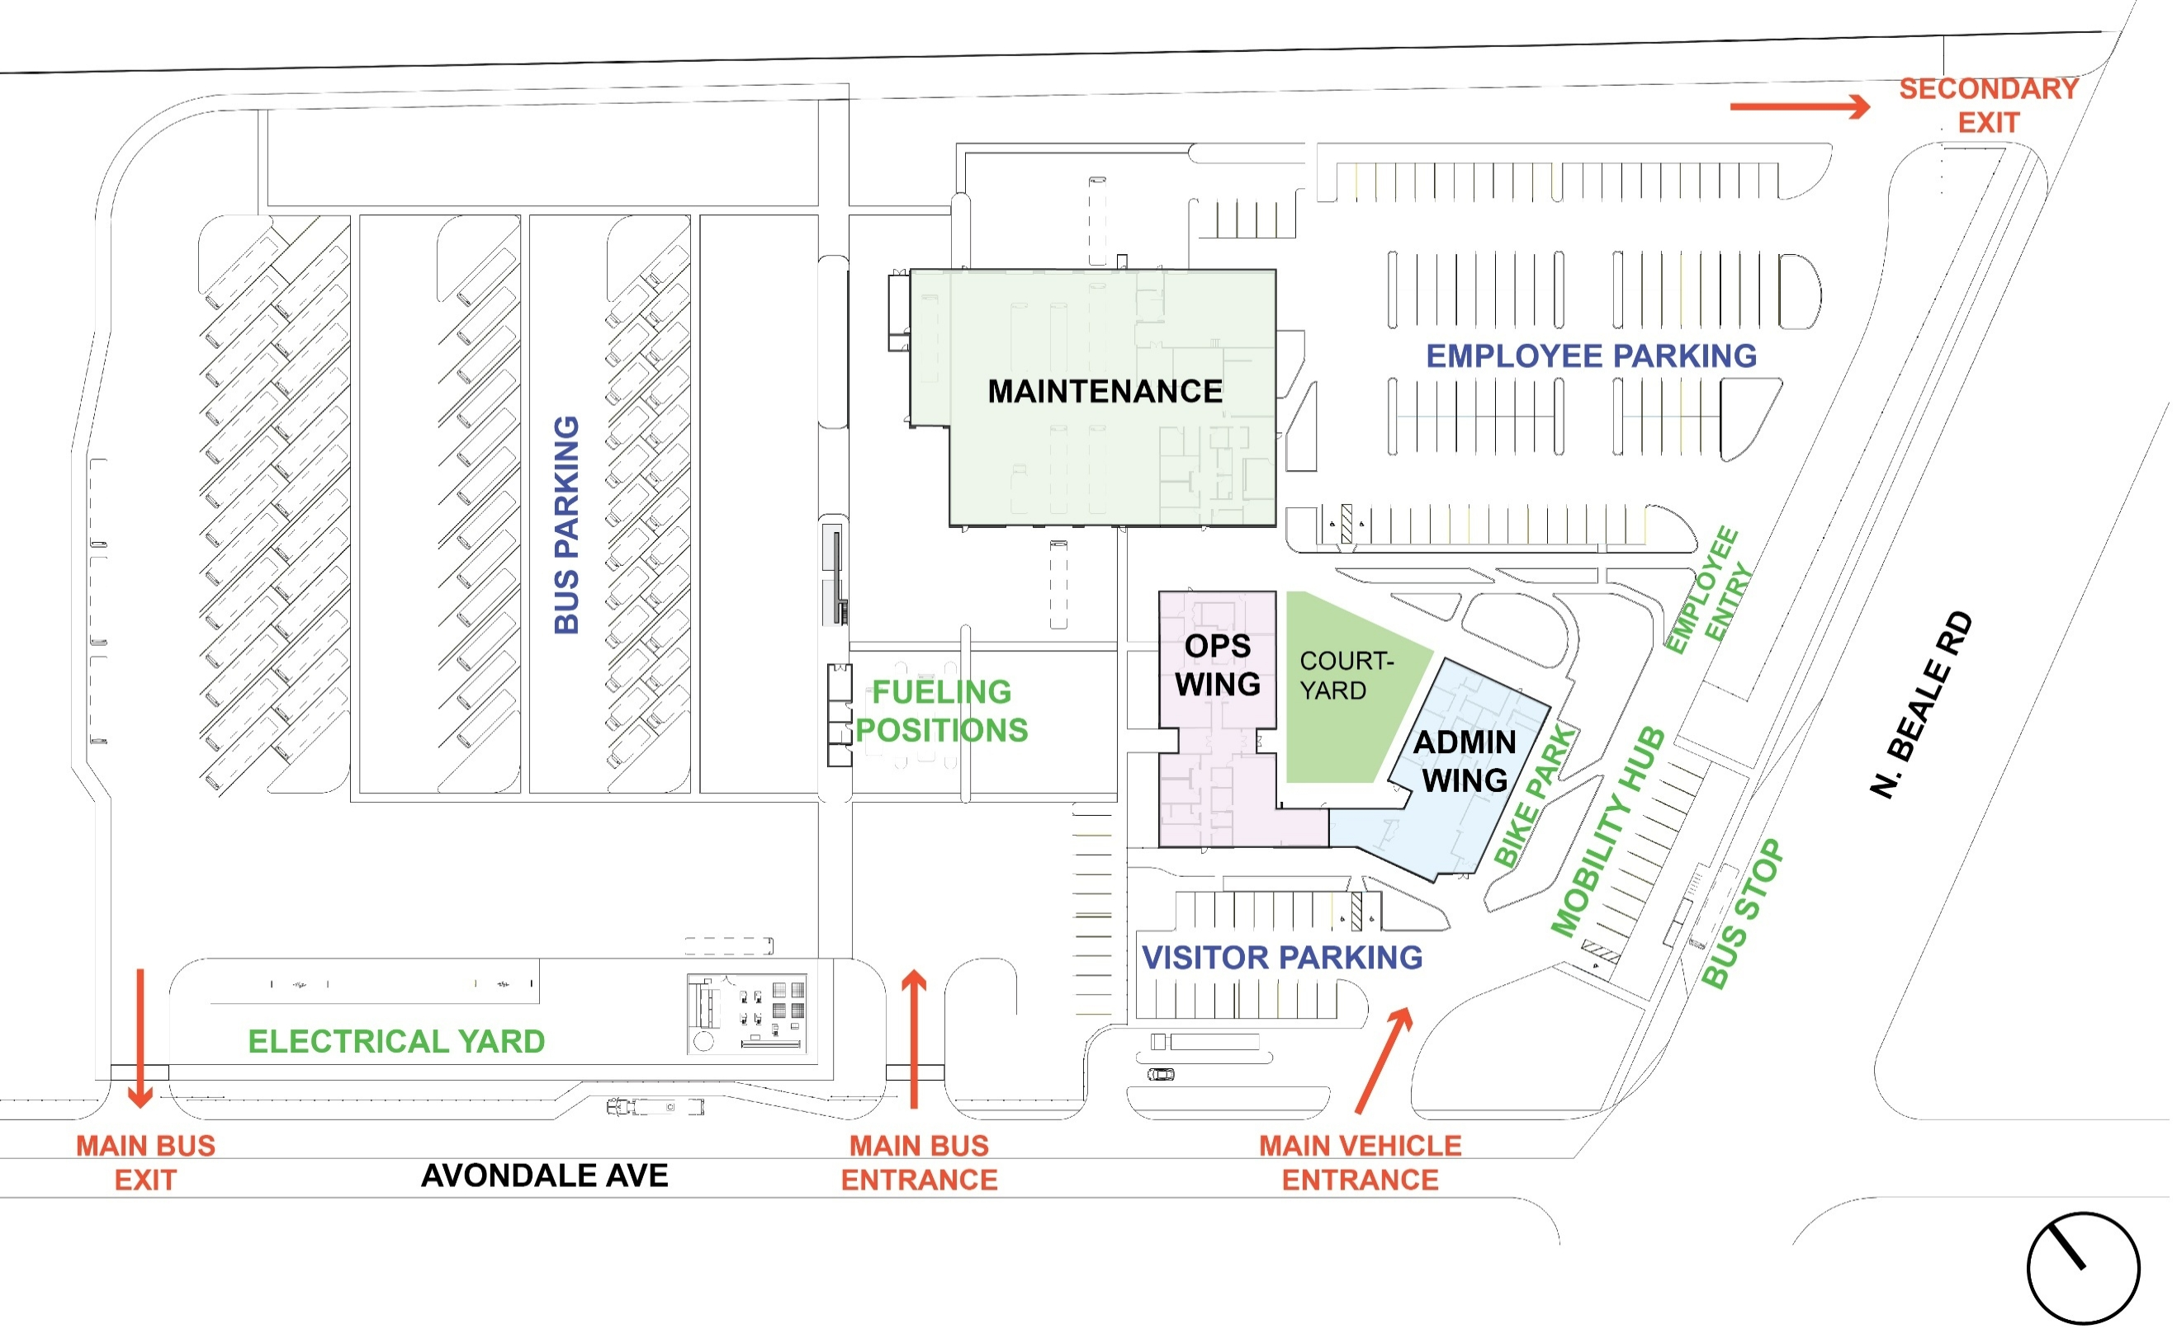
Key Facility Features
Bus Maintenance Facility
Administrative and Operations Facility
Fuel and Bus Wash facilities
Separate employee and visitor parking
Facility space needed to accommodate increases in operators and admin staff to support future service levels
New traffic signal at Beale/Avondale, including enhanced bus stop
Mobility Hub: Including secure bike storage.

Slide 8
Scope Overview
Yuba-Sutter Transit is requesting proposals from qualified firms to:
  Provide construction quality assurance and technical oversight services on behalf of the Authority, including oversight of the Design-Builder's compliance with the Contract Documents, scope, schedule, quality, safety, inspection, testing, commissioning, and related construction activities.
  Please see RFP for specific requirements

Slide 9
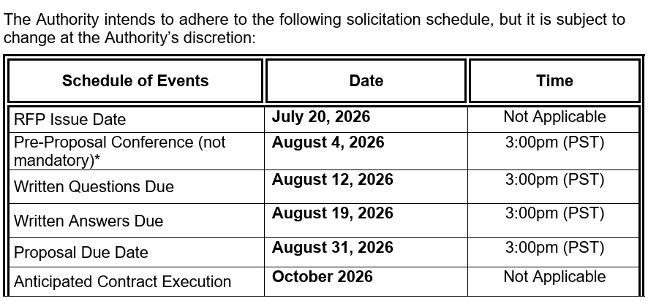
RFP Schedule of Events

Slide 10
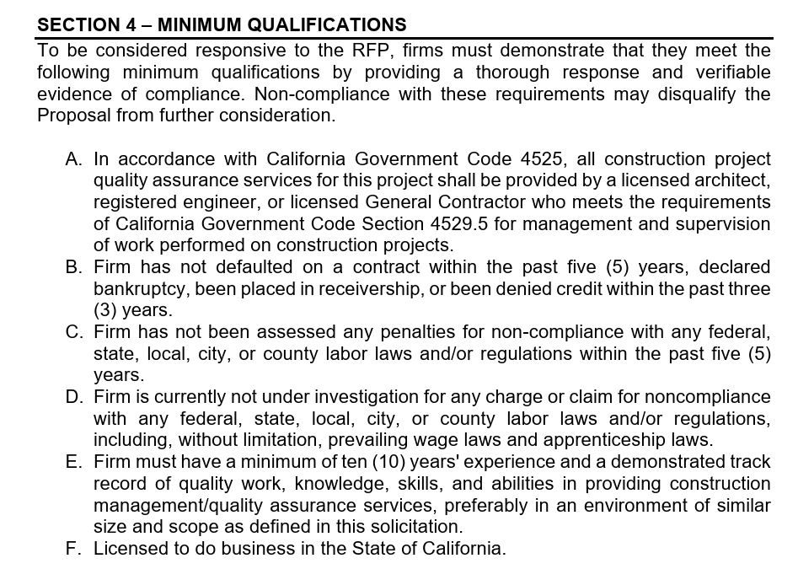
Proposer Minimum Qualifications

Slide 11
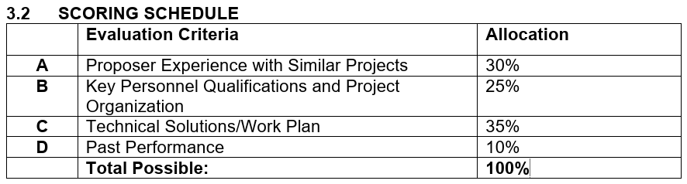
Proposal Evaluation
Selection of the Proposer will be made in accordance with California Government Code Section 4525 et. seq. The selection of professional services is made on the basis of demonstrated competence and professional qualifications necessary for the satisfactory performance of the services at a price determined by the Authority as being fair and reasonable. The Authority will evaluate Proposals with respect to established evaluation criteria.

Slide 12
Proposer Instructions
Review the RFP documents in their entirety.
Please ensure that your firm complies with all requirements of this RFP before submitting your proposal.
Failure to meet the requirements of the RFP may deem your proposal non-responsive.
Proposals must be submitted in strict compliance with the Proposal Instructions as prescribed within the RFP

Slide 13
Questions
All questions and inquiries should be formally submitted Adam@yubasuttertransit.com no later than 3:00 pm, PST, August 12, 2026.
Questions will be addressed via an addendum and posted on https://www.yubasuttertransit.com/current-requests-for-proposals
Verbal information provided during this meeting is strictly non-binding
The Authority wants to ensure all proposers receive the same information

Slide 14

Thank You

